Slide 1
Employee Data Analysis using Excel
NAME : N.harish kumar
&nbsp;
REGISTER NO. : 312218205
&nbsp;
DEPARTMENT: COMMERCE
User Name : FBA094D786E42019735434D2CBAB42B2&
COLLEGE : GOVERNMENT ARTS &amp; SCIENCE
Dr. RadhaKrishnan Nagar,Tondiarpet,ch-12

Slide 2
PROJECT TITLE
Employee average salary & average age analysis

Slide 3


AGENDA
Problem Statement
Project Overview
End Users
Our Solution and Proposition
Dataset Description
Modelling Approach
Results and Discussion
Conclusion
3/21/2024 Annual Review

Slide 4

PROBLEM STATEMENT
THE PROBLEM IS TO IDENTIFY AVERAGE SALARY AND AGE OF THE EMPLOYEE ACCORDING TO THEIR DEPARTMENT,GENDER & ROLE(ex:manager,process excecutive).

Slide 5

PROJECT OVERVIEW
IN THIS ANALYSIS IM GOING TO EASE THE PROCESS OF IDENTIFY THE EMPLOYEES AVERAGE SALARY & AVERAGE AGE USING EXCEL, WITH THE HELP OF BELOW MENTIONED TOOLS IN EXCEL.
TABLES.
SLICERS.
PIVOT CHART(LINE CHART,PIE CHART & BAR CHART).
BY INSERTING FORMULA TO MAKE INTERACTIVE DASHBOARD.

Slide 6

WHO ARE THE END USERS?
Human Resources (HR) Department
Finance Department
Compensation and Benefits Specialists
Operational Managers
IT and Data Management Teams

Slide 7

OUR SOLUTION AND ITS VALUE PROPOSITION
User-Friendly Interface:
Accessibility
Ease of Use
Comprehensive Data Management:
Data Organization
Data Integration
Advanced Analytical Tools:
Formulas and Functions
PivotTables
Visual Representation:
Charts and Graphs
Scenario Analysis:
Used to analyse different situation

Slide 8
Dataset Description
Data Overview:
The dataset contains information about employees within an organization, including their salaries and ages. This data is used to calculate and analyze average salary and average age metrics.
Data Fields:
ID
Name
Surname
Age
Tenure
Gender
Region
Department
Manager
Hours
Salary Band
Salary
Performance

Slide 9

THE "WOW" IN OUR SOLUTION
Dynamic Dashboards
Advanced Data Visualization
Segmentation Analysis
Comparative Analysis
Interactive Reports
Slicers
3/21/2024 Annual Review
9

Slide 10
MODELLING
Data cleaning.
Creating table.
Creating pivot chart.
Creating dashboard.
Inserting pivot chart in dashboard.
Inserting formulas in dash board to make interaction.
Creating interactive dashboard by putting all together elements.
10

Slide 11

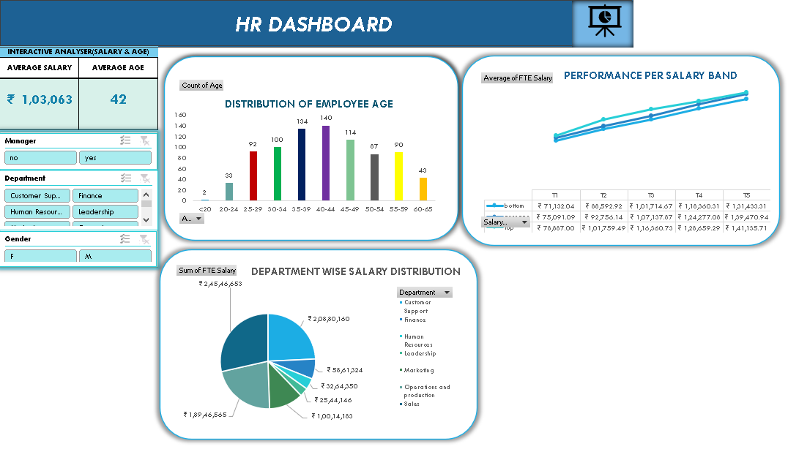
RESULTS
(click to open file)
11

Slide 12
Conclusion :
“The average salary and age analysis reveals important trends and patterns within the organization. By understanding these metrics, the company can make informed decisions to optimize compensation strategies, support career development, and align with industry standards. This analysis serves as a foundation for ongoing workforce planning and strategic decision-making”

